Slide 1
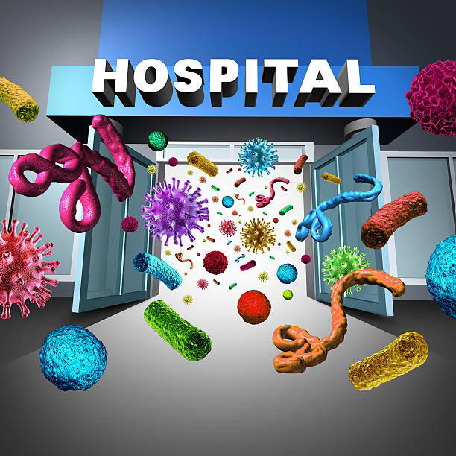
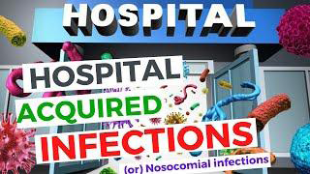
Nosocomial infection
Dr. Abdulmutalib A. Mohammed

Slide 2
Infection :
● Is the entry ,colonization and multiplication of a microorganism into the host tissues.
Nosocomial infection (Hospital infection) :
● An infection acquired in hospital by patient who was admitted for a reason other than that infection. This may become apparent during the stay of the patient in the hospital or after his discharge from the hospital. Also infection may occur among staff of health care facility.
● There is actual increase in the frequency and severity of infection especially due to antibiotic resistant Enterobacteria , Staphylococcus aureus and Pseudomonas aeruginosa .
● Thus prolonged stay of the patient in the hospital is undesired and may be a serious matter for the patient and his family.

Slide 3
● The most frequent nosocomial infections are infections of surgical wounds, urinary tract infections and lower respiratory tract infections.
● The WHO study, and others, has also shown that the highest prevalence of nosocomial infection occurs in intensive care unit and in acute surgical and orthopedic wards.
● Infection rates are higher among patients with increased susceptibility because of old age, underlying disease, or chemotherapy .

Slide 4
Classification of infection: 1- primary infection : is the initial infection caused by microorganisms incubated the host. 2- Reinfection : is the subsequent infection by the same organism in the same host . 3- secondary infection : is the new infection set-up by a new organism in a host whose resistance is lowered by preexisting infectious disease . 4- Focal infection : it is the infection at localized sites like appendix and tonsil. 5- Cross infection : when a patient suffering from a disease and a new infection is set-up from another host or external source. 6- Nosocomial infection : is the cross infection occurring in a hospital or hospital-acquired infection. 7- Subclinical infection : it is one where clinical affects or symptoms are not apparent .

Slide 5
Infectious Agents :
The patient is exposed to variety of microorganisms during hospitalization. The microorganisms are classified into two type:
● Saprophytic organisms : they are free living organisms live on decaying organic matter. they fail to multiply on living tissue and so are not important in infectious disease.
● Parasitic organisms : they are organisms that can establish themselves and multiply in living host tissues. They may be pathogens or commensals .
- pathogens are those which are capable of producing disease in a host such as many bacteria, viruses, fungi and parasites .
- Commensals are microbes can live in a host without causing any disease .
● The likelihood of exposure leading to infection depends partly on the characteristics of the microorganisms, including:
- Resistance to antimicrobial agents.
Intrinsic virulence (Invasiveness , Toxigenicity , Communicability).
- Amount of infective material.

Slide 6
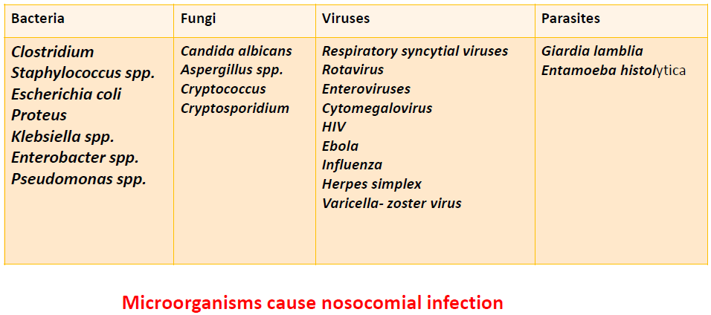

Slide 7
Characters of Pathogens
1- pathogen should be able to enter the body tissues. 2- pathogen should be able to multiply in the tissue . 3- pathogen should be able to damage the tissue . 4- pathogen must be capable to resist the host defense .

Slide 8
Factors assist to development and spread of nosocomial infections :
A. Patient susceptibility :
1- Age: Infancy and old age are associated with a decreased resistance to infection.
2- Immune status: Patient with acquired immunodeficiency syndrome (AIDS) have an increased susceptibility to infections with opportunistic pathogens.
Immunosuppressive drugs or irradiation may also lower resistance to infection.
3- Chronic disease: Patients with chronic disease such as malignant tumors leukemia, diabetes mellitus, renal failure are more affected than other.

Slide 9
B. Environmental factors
- Such as crowded conditions within hospital , Health care settings , frequent transfers of patients from one unit to another, and concentration of patients highly susceptible to infection in one area.
- Also contaminated objects, devices, and materials which subsequently contact susceptible body sites of patients.
C. Bacterial resistance:
- Many patients receive antimicrobial drugs ,and that over time will promote the emergence of multidrug resistant strains which persist and may become endemic in the hospital.

Slide 10
The most frequent Nosocomial infection sites:
1. Nosocomial pneumonia:
- Where the rate of infection in the lungs (pneumonia) in intensive care units is 3% per day.
2. Urinary infections:
- This is the most common nosocomial infection, 80% of infections are associated with the use of an indwelling bladder catheter and can occasionally lead to bacteremia and death.
3. Surgical site infections :
- They varies from 0.5 to 15% depending on the type of operation and underlying patient status.
4. Nosocomial bacteremia:
- These infections represent 5% of , but the incidence is increasing for certain organisms such as multiresistant coagulase-negative Staphylococcus and Candida spp.
- Infection may occur at the skin entry site of the intravascular device , or in the subcutaneous path of the catheter (tunnel infection).

Slide 11
Sources and transmission of nosocomial infection : 1. Skin. 2. Nasal tract. 3. Air. 4. Stool. 5. Clothes. 6. Workers and staff. 7. Pathogenic secretions and clinical samples of patients. 8. Water cycle of hospital. 9. All used instruments. 10. Operating room environment. Hospital Infection control team : - The team consists from : 1- infection control officer 2- infection control nurse 3- medical microbiologist

Slide 12
: Role of nurses in prevention of hospital acquired infection 1- Explaining the importance of hand washing to patients and who in contact with them . 2- Isolation of infected patients in private room ,e.g. measles , typhoid , etc. 3- Handling of blood , fluids , secretions and excretions using sterilized gloves . 4- Wearing of mask , gown , eye protector during any procedure likely to cause splash of body fluids , secretions , etc. 5- Carefully handling of soiled linen and body fluids . this is done to avoid transmission of microorganisms to other patients and environment . 6- Ensure the single use items proper disposal. 7- Proper sterilization of reusable items . 8- Restricting the entry of number of attendants of patient . 9- Making the patients to understand to avoid the over use of antibiotics . 10- Practically following the policies of infection control committee of the hospital (ICC) regarding use of disinfectants and hygiene practices.

Slide 13
Thank you

